Slide 1


E-Commerce
Customer Segmentation AND
PREDICTION
Using RFM Analysis & Machine Learning
PRESENTED BY
[Aniket Gaikwad]

Slide 2
INTRODUCTION
E-commerce
In today’s competitive market, businesses generate massive transactional data but struggle to convert it into actionable insights. Without . marketing efforts become generic, leading to low engagement and high churn.
This project aims to enhance marketing strategies and customer retention for an e-commerce company by gaining a deeper understanding of their customer base based on their purchasing patter. By leveraging machine learning, the project seeks to segment customers and predict future purchasing behavior.
CUSTOMER
SEGMENTATION

Slide 3





TABLE OF CONTENT
01
Project objective
02
Structured Workflow
03
Data overview
04
Data cleaning process
05
RFM feature engineering
06
Modeling Techniques
07
Model prediction
08
Model deployment
09
Conclusion

Slide 4

Project Objective
This project aims to segment e-commerce customers based on purchasing behavior and predict their future category using machine learning techniques. The objective is to build a robust RFM-based segmentation model and a predictive classifier that categorizes customers into meaningful groups, enabling data-driven marketing strategies, improved customer retention, and optimized business decision-making.

Slide 5


STRUCTURED WORKFLOW
1
Data collection
Imported raw e-commerce transactional dataset
Original shape: 541,909 rows × 8 columns
2
Data Cleaning & Preprocessing
Removed missing CustomerID
Removed cancelled invoices etc
3
Exploratory Data Analysis (EDA)
Analyzed purchase behavior
Detected presence of outliers
4
Feature Engineering – RFM Calculation
Grouped transactions by CustomerID and calculated:
Recency
Frequency
Monetary
6
Unsupervised Model Implementation
8
Cluster Interpretation
Tested multiple clustering algorithms:
KMeans
Hierarchical Clustering
DBSCAN
Analyzed average RFM values per cluster
and Labeled clusters
5
Feature Scaling
9
Supervised Prediction Phase
Applied StandardScaler Required because clustering is distance-based
Prevented Monetary from dominating model
7
Model Evaluation & Selection
Used cluster labels as target variable
Trained:
Logistic Regression
Random Forest
Compared models using Silhouette Score

Slide 6

Dataset Overview
The original dataset consisted of 541,909 transactional records with 8 features, including - InvoiceNo
- StockCode
- Description
-Quantity
-InvoiceDate
-UnitPrice
-CustomerID
-Country.
After data cleaning, removing missing CustomerID values, cancelled invoices, and invalid transactions the dataset was reduced to 397,884 valid transactions. These transactions were then aggregated at the customer level, resulting in 4,338 unique customers. The segmentation and prediction analysis were performed on this customer-level dataset using engineered RFM features to capture purchasing behavior effectively.

Slide 7

Data cleaning process
01
02
Created Clean Dataset
Checked for Missing Values
Preserves original raw dataset and ensures safe preprocessing without data loss.
Dropped rows where CustomerID was null.Transactions without CustomerID cannot be used for grouping or RFM calculation.
03
04
Removed ‘C’ Transactions
Removed Negative / Invalid
Filtered out invoices where InvoiceNo started with ‘C’. represent cancelled or returned transactions and do not reflect actual purchasing behavior. Including them would distort Frequency and Monetary metrics
Excluded rows with negative Quantity. Required for calculating RFM, which measures the number of days since a customer's last purchase and frequent purchase
05
Converted Date Format
InvoiceDate to datetime format. Invoice Required for calculating Recency, which measures the number of days since a customer's last purchase.

Slide 8
RFM FEATURE ENGINEERING
CREATED TOTALAMOUNT FEATURE
CREATED A NEW COLUMN: TOTALAMOUNT = QUANTITY × UNITPRICE
REASON: THE DATASET DID NOT DIRECTLY CONTAIN TOTAL SPENDING PER TRANSACTION. MONETARY VALUE CALCULATION REQUIRES TOTAL PURCHASE AMOUNT PER INVOICE.
AGGREGATED DATA AT CUSTOMER LEVEL
GROUPED TRANSACTIONS BY CUSTOMER ID.
CONVERTED TRANSACTION-LEVEL DATA INTO CUSTOMER-LEVEL DATA.
REASON: SEGMENTATION IS PERFORMED AT CUSTOMER LEVEL, NOT TRANSACTION LEVEL.
Recency (R) | Frequency (F) | Monetary (M)
Calculated number of days since the customer's last purchase. Reason: Measures how recently a customer engaged with the business | Counted total number of invoices per customer. Reason: Indicates how often a customer makes purchases. | Calculated total spending (sum of TotalAmount) per customer. Reason: Identifies high-value customers.

Slide 9
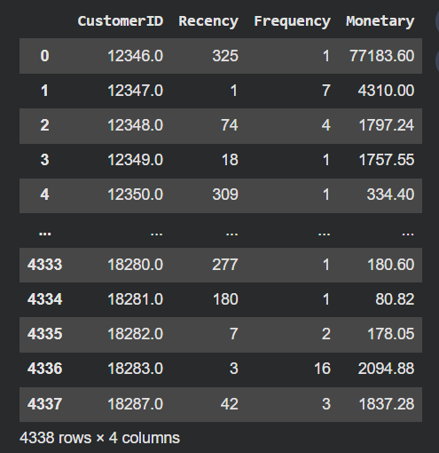
RFM FEATURE ENGINEERING
CREATED FINAL RFM TABLE
RESULTED IN 4,338 UNIQUE CUSTOMERS WITH RFM VALUES.
THIS DATASET BECAME THE BASE FOR CLUSTERING AND PREDICTION.
“FEATURE ENGINEERING TRANSFORMED RAW TRANSACTION DATA INTO MEANINGFUL BEHAVIORAL METRICS USING RFM ANALYSIS, ENABLING STRUCTURED AND INTERPRETABLE CUSTOMER SEGMENTATION.”

Slide 10
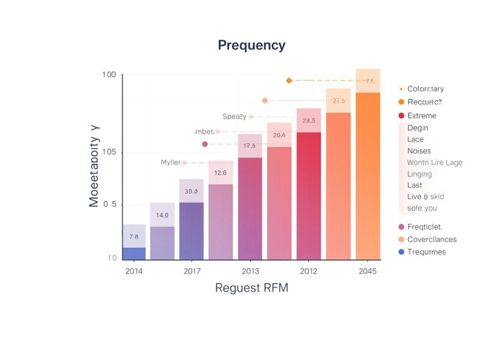

Outlier observation
Extreme Values
Retention
Outliers
Consistent purchases indicate strong customer loyalty.
Higher-value outliers show significant customer interest.
High Monetary and Frequency outliers indicate vital customer segments.Few customers generate significant revenue spikes.High-frequency customers drive significant sales growth.
Trends
Majority of customers spend small amounts regularly.
Very few customers spend extremely high amounts.
Right-Skewed Distribution
💡 Why We Retained the Outliers
These extreme values represent high-value or VIP customers, not data errors.
Removing them would eliminate important business segments.
Customer segmentation aims to identify valuable customers, including extreme spenders.
High monetary value is a real behavioral characteristic in e-commerce data.
Therefore outiers were not removed from the dataset
The distribution showcases high-spending customers, affecting overall RFM analysis.Slight right skew indicates customer engagement levels.

Slide 11

🔹 Feature Scaling
Why Scaling Was Required
RFM features are on different scales:
Recency → Days
Frequency → Count
Monetary → Currency
Monetary had very large magnitude.
Distance-based algorithms (K-Means, Hierarchical) are sensitive to scale.
– Action Taken:
Applied StandardScaler
Ensured equal contribution of all features
🔹 Dimensionality Reduction (PCA)
Why PCA?
To reduce feature redundancy
To visualize clusters in 2D space
To improve clustering structure
- Action Taken
Applied PCA on scaled RFM data
Selected principal components explaining maximum variance
Used PCA output for visualization and better separation understanding

Slide 12

Modeling Techniques
Implemented and compared:
K-Means Clustering
Hierarchical Clustering (Agglomerative)
DBSCAN
🔹 Evaluation Metric
Used Silhouette Score to measure cluster quality
Score range: -1 to 1
Higher score = Better cluster separation
🔹 Model Comparison
K-Means → Silhouette Score ≈ (0.6162)
Hierarchical → Silhouette Score ≈ (0.6073)
DBSCAN → Silhouette Score ≈ (0.6743).
The comparative analysis of Silhouette Scores highlights K-Means as the most effective model for actionable customer segmentation, balancing interpretability and cluster representation. Although DBSCAN achieved the highest score, it produced only two broad clusters (primarily VIP vs Others), limiting actionable business segmentation. K-Means, with a strong Silhouette Score of 0.6162, generated well-balanced, interpretable, and business-meaningful customer groups, making it the preferred model.

Slide 13
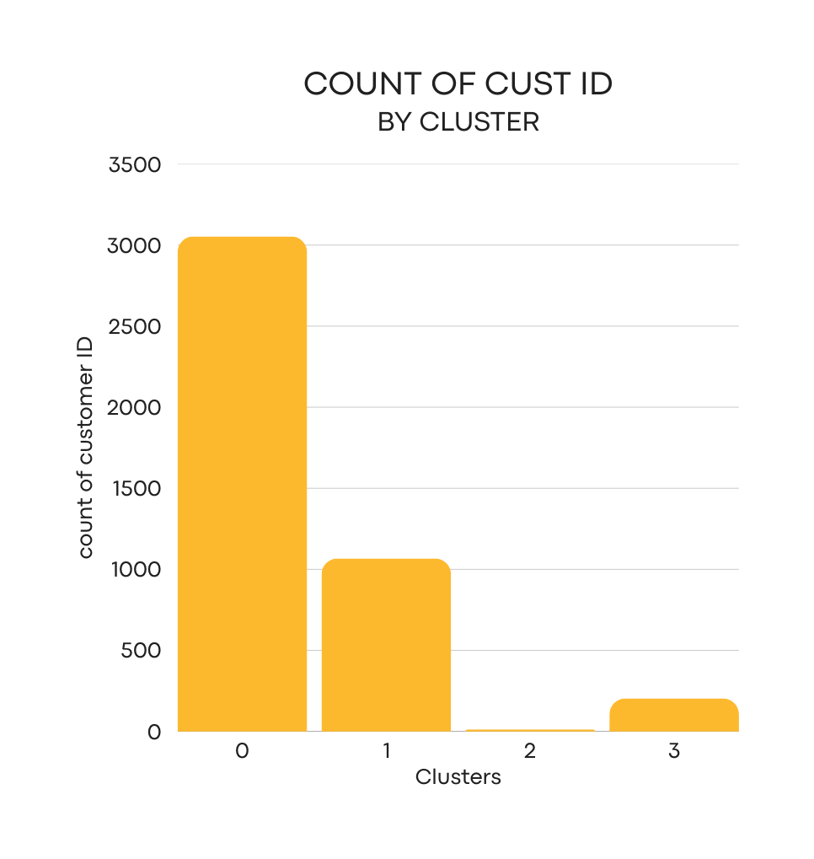
Customer Clusters
Utilizing the K-Means model with a Silhouette Score of 0.6162, we have identified four distinct customer clusters. Each cluster reveals unique purchasing behaviors, enabling targeted marketing strategies and personalized engagement to enhance customer retention and optimize resource allocation.
🔹 Cluster 0 – Regular Customers
Moderate Recency
Stable and consistent buyers
Important for maintaining steady revenue
🔹 Cluster 1 – Lost / Low-Value Customers
Low Monetary
High churn risk
Require reactivation strategies
🔹 Cluster 2 – VIP / High-Value Customers
Very High Monetary
Core revenue-driving segment
Ideal for loyalty programs and exclusive offers
🔹 Cluster 3 – Potential Loyal Customers
Decent Frequency
Growing customer segment
Opportunity for nurturing and upselling

Slide 14


Model Prediction
Models Implemented
Logistic Regression
Random Forest Classifier
LOGISTIC REGRESSION
We implemented Logistic Regression to predict customer segments,
Accuracy: 1.00 (100%)
Precision, Recall, F1-Score: 1.00 across classes
Test Samples: 868
Very strong linear separation observed
Key Observation
Dataset was imbalanced (one cluster had only 4 samples).
Clusters were created using RFM features, and the same RFM features were used for prediction.
This resulted in naturally high classification accuracy.
RANDOM FOREST
🔹 Why Random Forest Was Selected
Although Logistic Regression achieved perfect accuracy, Random Forest was selected due to its robustness, flexibility, and stronger real-world reliability.
Captures non-linear relationships between Recency, Frequency, and Monetary.
More robust to real-world data variations.
Handles class imbalance more effectively.
Provides better generalization capability for unseen data.
More suitable for production deployment.
The Random Forest model was tested alongside Logistic Regression, resulting in a
Accuracy: 0.9965 (99.65%)
Strong performance across major clusters
Better handling of feature interactions
More stable across imbalanced classes

Slide 15
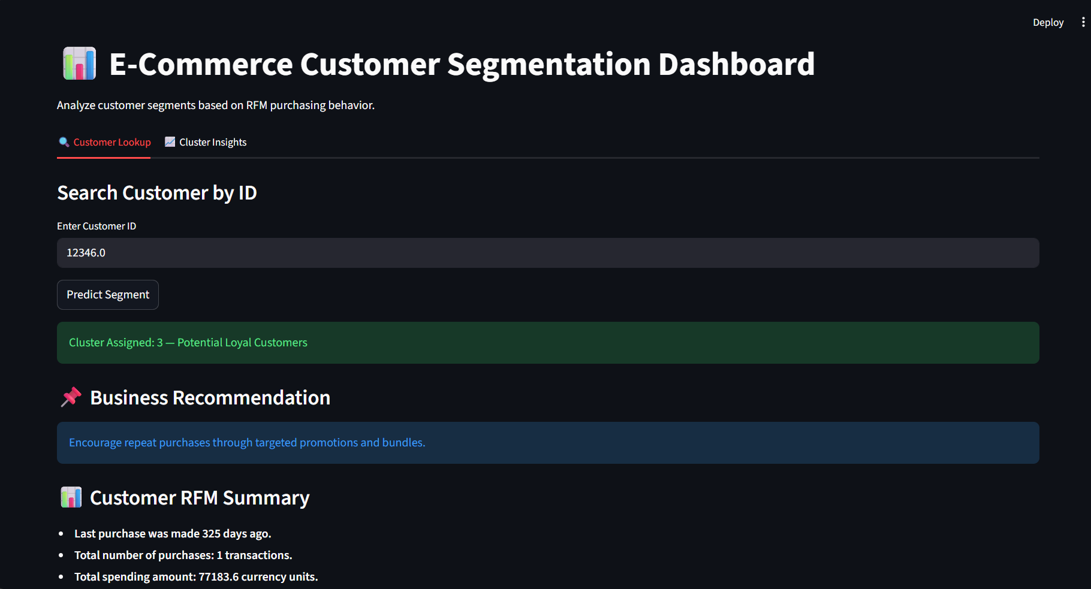
Model Deployment Process
Finalized Random Forest model after performance comparison.
Saved trained model using serialization (e.g., Pickle/Joblib).
Integrated model with RFM feature pipeline for real-time predictions.
Output can be used by marketing teams for targeted campaigns and retention strategies.

Slide 16



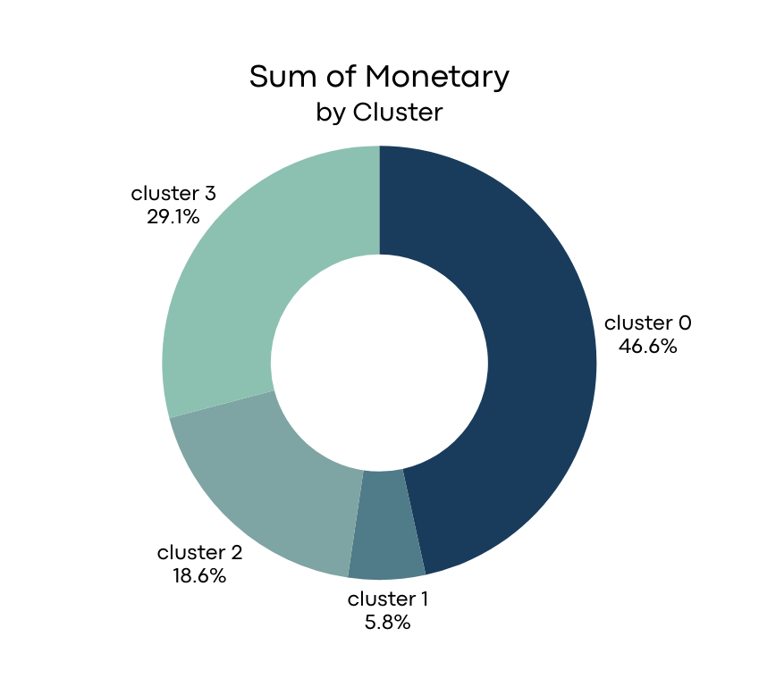
Conclusion
successfully developed a robust customer segmentation and predictive modeling framework for an e-commerce business by leveraging RFM-based behavioral analysis and machine learning techniques. Through detailed exploratory analysis, data preprocessing, clustering comparison, and model evaluation, customers were segmented into four meaningful behavioral groups that reflect purchasing frequency, recency, and spending value
Business Insights
Majority revenue is driven by a small % of VIP customers.
Lost customers represent revenue recovery opportunity.
Potential Loyal customers can be converted into VIP with targeted marketing.
Segmentation enables cost-effective campaign strategy.
Identified high-value, loyal, potential, and churn-risk customers through our segmentation pipeline, providing actionable business insights and visual dashboards for enhanced decision-making.

Slide 17




THANK
YOU

